Slide 1
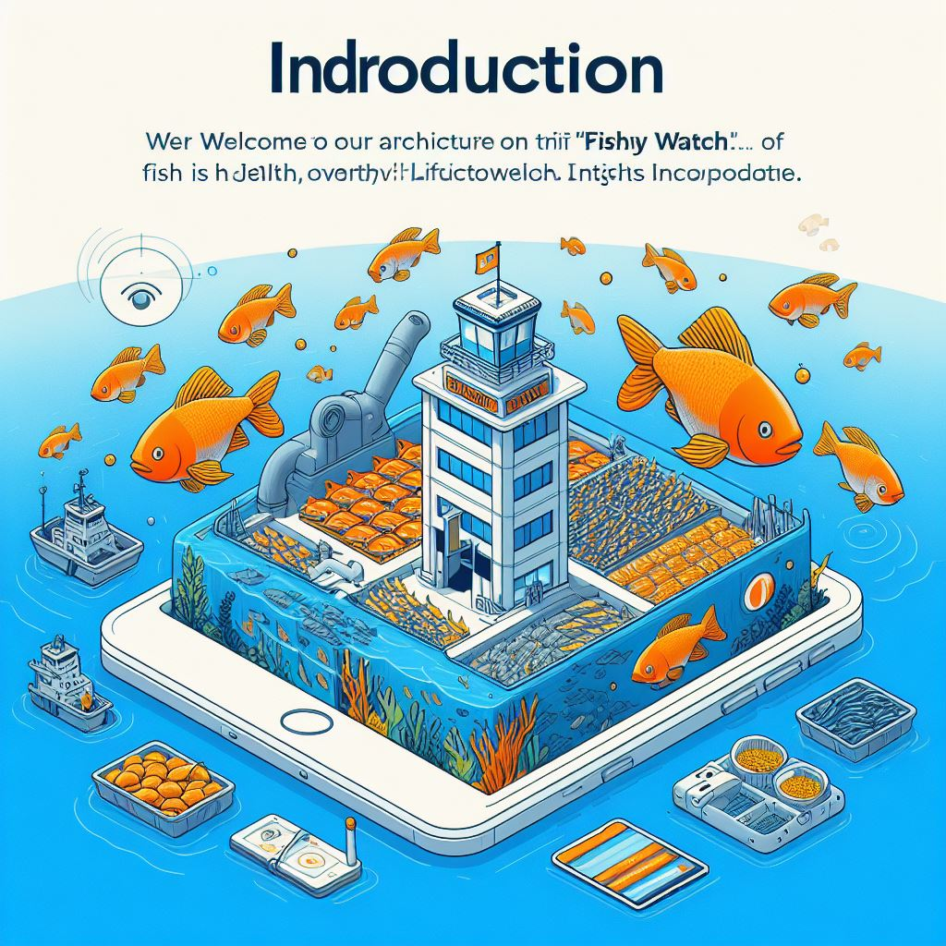
Fish WatCH System Architecture
Notes:
Once upon a time, in the rolling hills of Scotland, Livestock Insights Incorporated set sail on a daring mission. Their flagship service, Fishy Watch, was destined to revolutionize fish farming across the globe. Fish farmers, with nets in hand, eagerly awaited the dawn of a new era.
Introduction “Welcome to our presentation on the architecture of Fishy Watch, a flagship service of Livestock Insights Incorporated. Fishy Watch is a global service that enables fish farmers to monitor fish health and overall farm conditions.”

Slide 2
About us – Finastra Innovators
Suresh B
Kanakaraj Chinnamuthu
Rajesh Kumar Nair
Jayesh Prajapati
Our purpose is to unlock the potential of people, businesses and communities everywhere. Our values are Be Open , People First and Do well by doing Good. Our behaviors are Customer centric, Strong together, Growth mindset and Shared accountability.

Slide 3
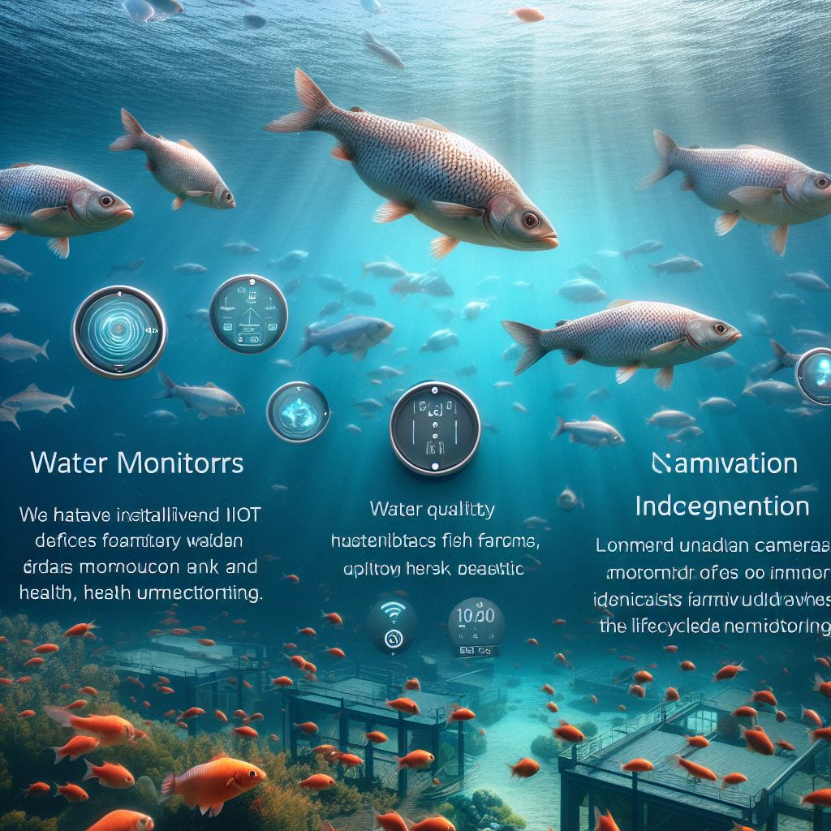
Monitoring Devices
“We have installed various IoT devices in fish farms. Water Monitors capture water quality data, and Underwater Cameras monitor fish health. We also have a beta feature, Fish-ual Recognition, that identifies individual fish for health and lifecycle monitoring.”

Slide 4
Business Drivers and Goals
Drivers
Global Operations
Goals
Customizable Dashboards
Diverse Clientele
Data Collection and Analysis
Real-time Alerts
Cross-platform Accessibility
Predictive Analysis
Device Integration
Cross-farm Insights
Future Expansion.
Timely Alerts.
Remote Accessibility
Scalability
Multi-species Support
4

Slide 5
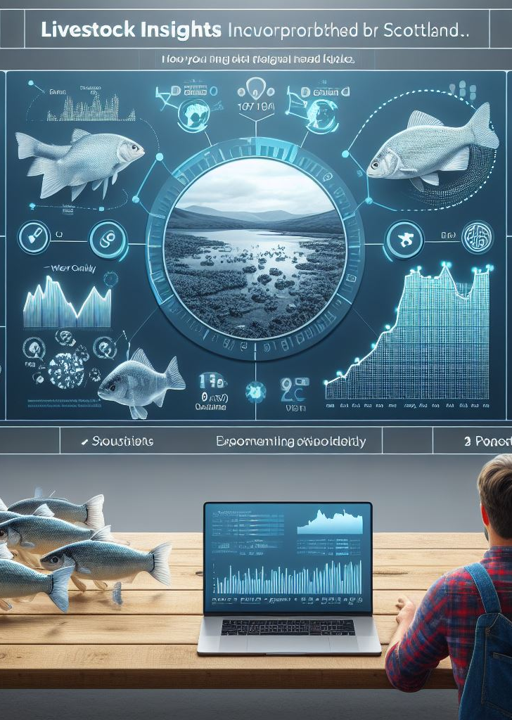
Company overview
Notes:
Slide 2 - Company Overview “Livestock Insights Incorporated, headquartered in Scotland, operates globally. Fishy Watch collects critical data about individual fish, water quality, and weather conditions, helping farmers assess livestock health, detect signs of parasites and diseases, and optimize harvest timing.”

Slide 6
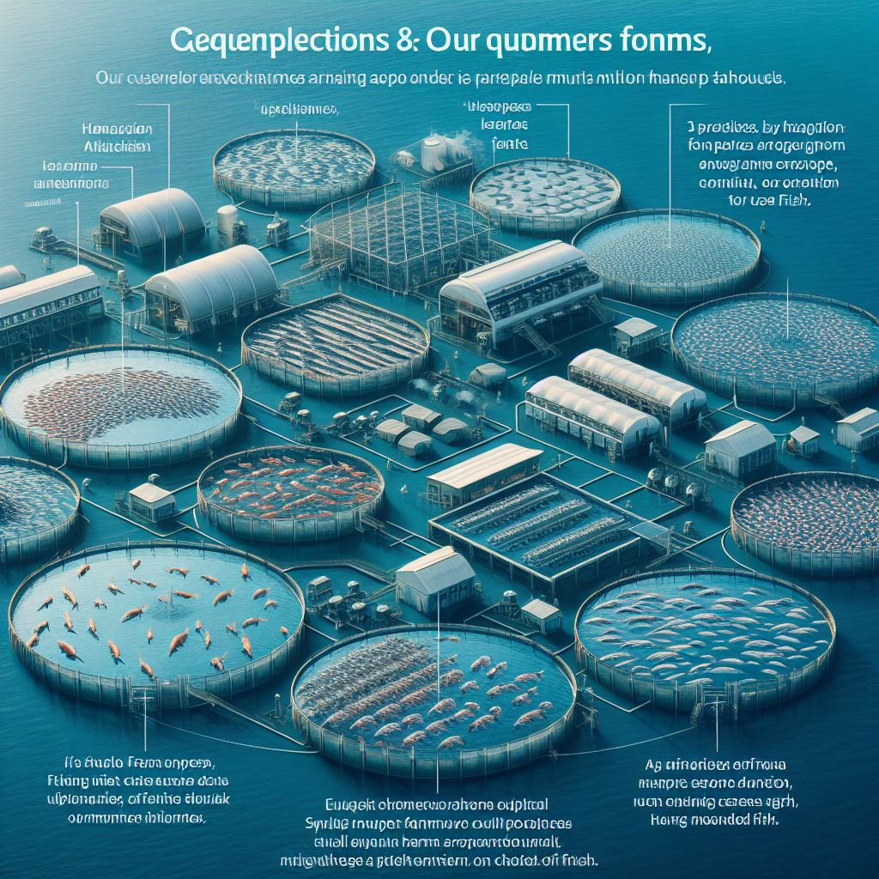
Requirement overview
Our customers operate multiple fish farms across different geographical locations, with farm sizes varying from small single-farm operations to large clients managing over a hundred farms. Each farm consists of multiple enclosures where fish are kept, and the largest farms may house millions of fish

Slide 7
Dashboard Customization and Alerts
“Farmers need customizable dashboards to view collected data and specify alert thresholds. Raw data, combined with harvested fish information, informs models for optimal harvest conditions..”

Slide 8
Accessibility and Connectivity
Our system is accessible from various devices, including rugged industrial ones used during sea harvests.
Fish farms often operate in remote areas with poor cellular signal,
so we have defined how existing hardware devices will transmit water and fish behavior data to the system.

Slide 9
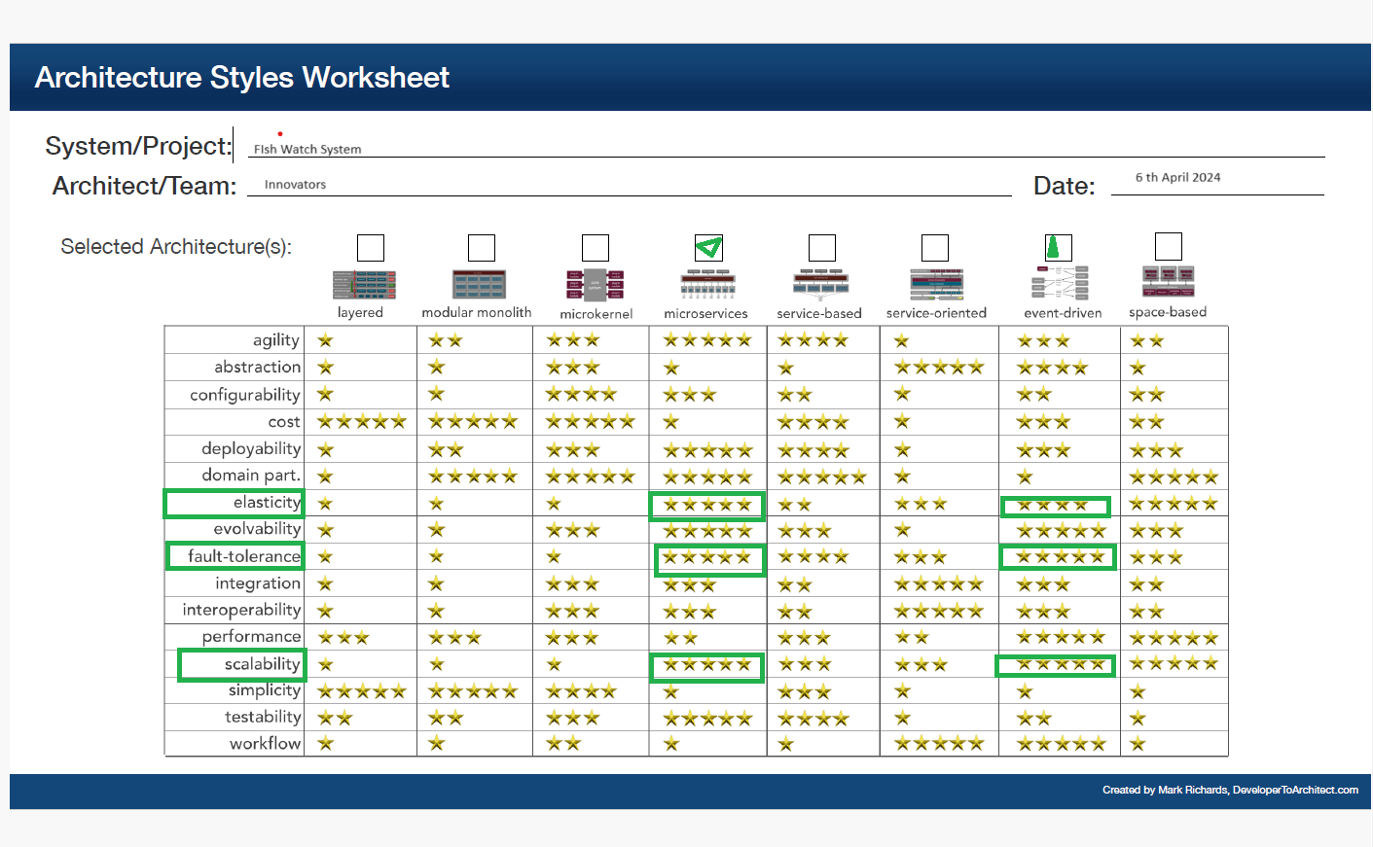
Architecture Styles
ADR_001
We compared a few styles and finalized one that will give us the most benefits with respect to the non-functional properties. As shown in the table, Microservices and event-based architectures were the most suitable candidates.

Slide 10
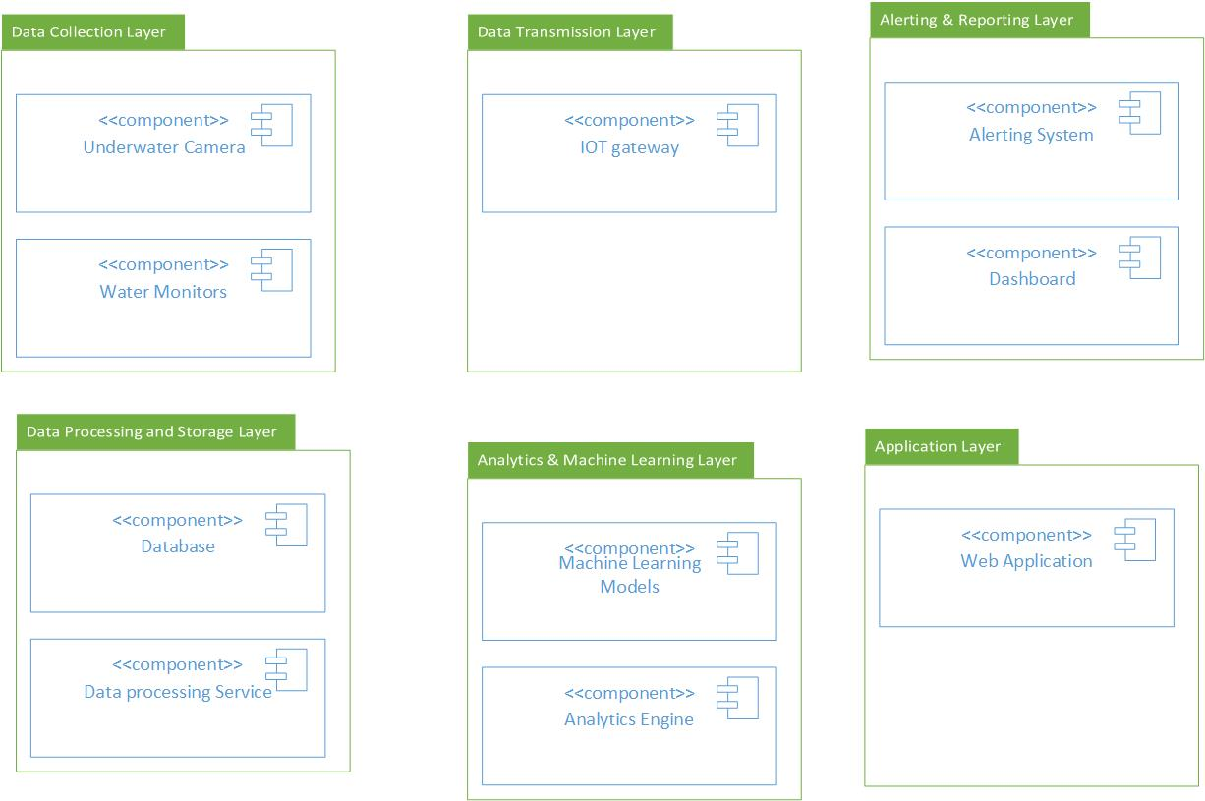
Fish WatCh Application components

Slide 11
Fish Watch Application features
Dashboard Overview
Overview dashboard
Customizable dashboard
Farm Overview
Users can select a specific fish farm from a list
Farm overview provides essential details about the selected farm
Enclosure Details
Enclosure ID (unique identifier).
Alerts and Thresholds
Fish Harvest Tracking
Insights and Analytics
Multi-Farm Insights
Critical information like
Active alerts (if any).
Recent health status summary
Total number of fish farms.
Number of Enclosures.
Total Fish Count.
Water Quality Summary (pH, temperature, salinity, oxygen levels).
Recent Fish Health Status (based on underwater camera data).
Alerts (highlighted issues)
Fish Count (current population).
Water Quality Metrics (real-time graphs).
Fish Behavior (live video feed from underwater cameras).
Parasite Detection Status (alerts if parasites detected).
Fish-ual Recognition (if available).
Users set custom thresholds (e.g., pH, temperature).
Alerts triggered when thresholds exceeded:
Visual Alerts on Dashboard (highlighted areas or color changes).
Email/SMS Notifications.
Separate section to track harvested fish:Input Harvested Fish Count.
Record Date and Time.
Associate with Specific Farm and Enclosure
ystem analyzes historical data to improve harvest success:Correlations (water quality, fish behavior, successful harvests).
Predictive Models (optimal harvest timing).
For large customers with multiple farms:
Compare Performance Across Farms.

Slide 12
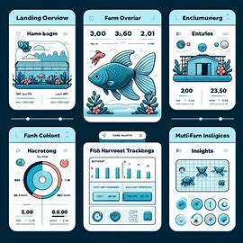
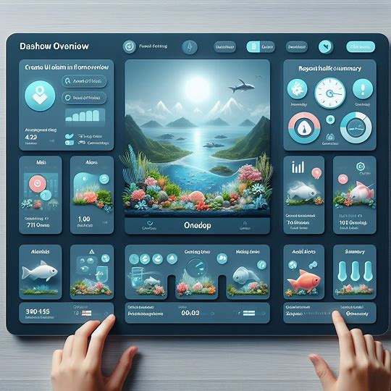
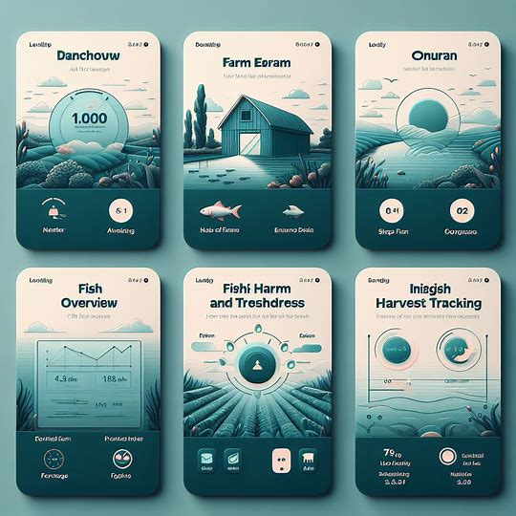
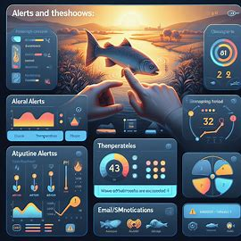
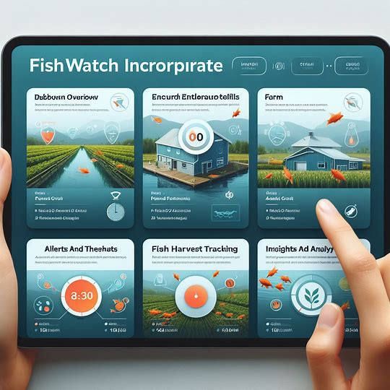
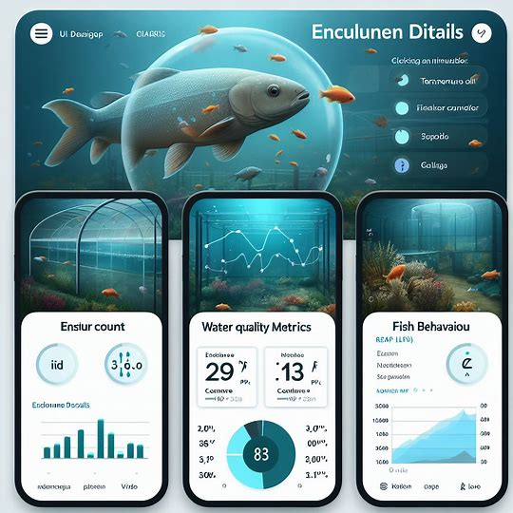
Fish WatCh Application UI MOCKUP

Slide 13
User Story
Data Collection
Collect water quality data from each enclosure in a fish farm.
Data Processing and Analysis
Process and analyze the collected data to understand livestock health and detect signs of parasites and disease.
Alert System
Generate alerts when predefined thresholds are breached.
Collect fish behavior data from underwater cameras in each enclosure.
Identify individual fish using fish-ual recognition to monitor their health and lifecycle.
The proposed system is a smart IoT-based fish monitoring and control system equipped with different IoT devices to enable real-time data collection.
The fishfarm container water-quality conditions and other system parameters can be readily monitored, adjusted, and assessed remotely.
Use the data and harvested fish information to build a model for optimal harvest conditions.
To predict the growth of the container fish species, this also develops a deep learning model (DL) that correlates the different parameters of the smart aquaculture system.
Example of Autonomous feeding system:
Bayesian optimization-based hyper-parameter tuning was employed to find the optimal DL model configuration to produce accurate predictions on the given experimental data set.
The optimal model produces an R 2 value of 0.94 and a mean square error of 0.0015, demonstrating the applicability of the model to predict the desired output.
Based on the results of the experiments, the DL model can be incorporated into the autonomous feeding system, reducing the amount of leftover feed.
User Interface
Farmers need:
Customizable dashboards to view collected information.
Specify alert thresholds.
Provide advanced warnings of adverse weather events.
Data Storage
Store processed data and analysis results securely for future reference.
System Accessibility
Farmers can access FishWatch from various devices, including rugged industrial ones used during harvest.
Device Communication
Define how hardware devices will transmit information to the system.
Consider poor cellular signal in remote fish farm locations.
Future Considerations
Automatic detection of fish ready to harvest and use of pump to direct cultivated fish to shipment tank
Extend similar capabilities to cattle monitoring.
Allow aquariums to use the system for fish health management.

Slide 14
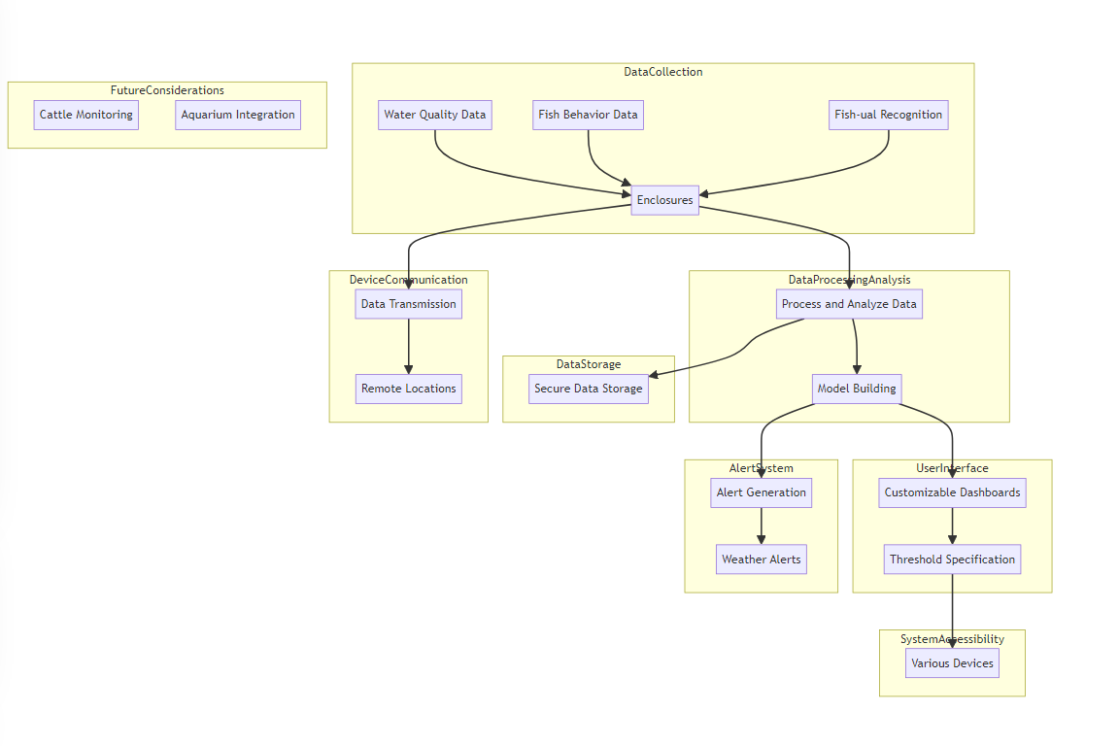
Fish Watch Application User Stories

Slide 16
Thank you
Brita Tamm
502-555-0152
brita@firstupconsultants.com
www.firstupconsultants.com

